Slide 1

We Engineer your Digital Success
Proposal for Development of an Expert Training & Arbitration System for Society of Engineers - UAE
July 2016
© 2016. All Rights Reserved / www.verbat.com

Slide 2

Contents
1
Background & Scope
2
Solution Overview
3
Application Functionality
4
Discovery Phase
5
Technology Specifications
6
Project Timelines & Commercials
7
Terms & Conditions
8
Out of Scope

Slide 3
Background & Scope
Society of Engineers – UAE, accredits Engineering certifications, Regulating professional practices, Standards and specifications and developing the skills and qualifications of all engineers in the UAE by their International accreditation committee. They train and certify people as Experts in their respective fields and participates in solving arbitration cases with the cooperation of Courts. The Arbitration Committee maintained by the Society of Engineers - UAE is responsible for resolving claims and disputes between two legally binding parties amicably.
Scope
The Society of Engineers Intends to develop an Expert Training and Arbitration Management System to facilitate the following;
The selection, training and certification of experts for Court
Track the status and stages of the Expert Training & Certification workflow
Assigning of arbitrators to cases for dispute resolution
Track the status and stages of the Arbitration management system workflow

Slide 4
Scope (Contd..)
System will be composed of two major workflows
Expert management system for training and certification of experts
Manage applicants
Manage online and offline tests , add questions, create test, evaluate and publish results etc.
Ability to track the stages and the status of the applications
Ability to conduct online payments and transactions
Email Notifications to applicants
File management regarding qualifications of applicant
Arbitration management system to settle disputes
Provision to manage different stakeholders –SOE User, Arbitrators, Chief Arbitrator & other users
Provision to manage the case documents and assign case to the arbitrators
Ability to track the status of the case filed
Ability to conduct online payments and transactions

Slide 5
Solution Overview

Slide 6
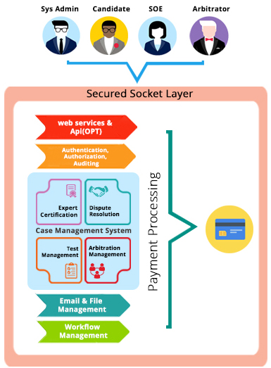
Solution Overview
System provides an Optional web service layer to integrate the application with mobile devices
The main components of the application are
Authentication, authorization to distinguish the logged in user, auditing to track the progress of the workflow
The case management system consist of two distinct workflows
Expert Certification for applicants - Test management and administration system
An Arbitration Management system for SOE to allocate and deallocate cases to arbitrators and for managing the arbitration process
The above workflows are built on a common framework
The system will also have a built-in file management, email notifications and scheduling services to send reminder emails to concerned parties
The application can also be integrated with an online payment system to manage fee collection

Slide 7
Application Functionality

Slide 8
Functionality
SOE
SOE Functionality for Applicants
User authentication and entitlement
Create applicant profile and upload relevant documentation
Update status of the applicants for test and lesson plans
Fee collection from applicants for tests and lesson plans
SOE Functionality for Managing Test
Create and manage objective type questions
Record the test results with comments
Evaluation and Test grading functionality
Manage Arbitrations
Manage Arbitration cases
Ability to view arbitration cases
Assignment of cases to chief arbitrator
Ability to view case status
Specify the commission for SOE for facilitating arbitration
SOE will facilitate the meetings between arbitrators and clients for dispute resolution
Fee collection from clients for arbitrating cases

Slide 9
Functionality (Contd..)
Candidate
Client
Functionality for taking Objective test
Functionality to make payment for Objective test
Functionality to receive reminder mails and status of the selection process
Clients can create profile and upload documents relevant to their case
Email notification on the cases
Payment for case arbitration
Escalate the case to the Chief Arbitrator if they are not satisfied with the results of the judgement

Slide 10
Functionality (Contd..)
Chief Arbitrator Functionality
Cases can be viewed by the Chief Arbitrator assigned by the SOE
Chief Arbitrator can reassign the cases to other Arbitrators who are specialized in handling the case
The Chief Arbitrator can receive feedbacks from the fellow Arbitrators
The Chief Arbitrator can enter the meeting minutes into the system
Chief Arbitrator can assign the case to a single arbitrator pending review and receive feed back from fellow Arbitrators
Once the case is resolved the Chief Arbitrator can relieve the assigned Arbitrator from the case
The Chief Arbitrator can receive an escalation if the clients are not satisfied with the verdict
Assigned Arbitrator Functionality
Assigned Arbitrators can receive the cases assigned to them by the Chief Arbitrator
The Arbitrator can accept or reject the case
The results of the judgement along with meeting minutes can be viewed that are recorded in the system

Slide 11
Discovery Phase

Slide 12
Requirements Gathering
On signing the contract, Verbat will deploy a senior Technical Architect and a senior Business Analyst to discuss the business and technical requirements, define the solution approach, deliverables during each phases of execution, documentation and sign-off
Deliverables
High level technical design
Detailed requirement specification document
Wireframes for the key screens for the proposed web application
Dependencies
The client to nominate a POC to coordinate with our team
Availability of key stakeholders for meetings to discuss requirements and validate findings and deliverables
Written sign-off on the deliverables prior to commencement of the development phase

Slide 13
Technology Specification

Slide 14
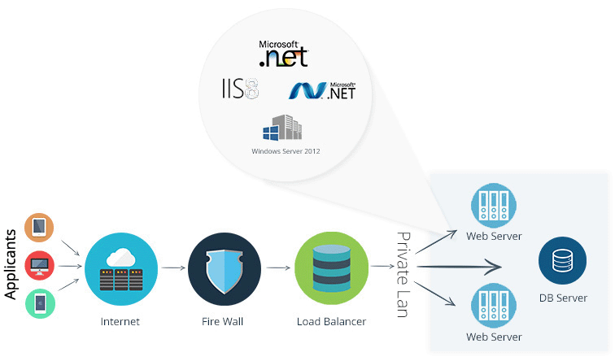
Technology Specifications
Technology Stack
Language – ASP.Net 4.5
Database – MS SQL 2012 Enterprise Edition
Server – IIS 7.5
Operating System – Windows
Server and Hosting
Dedicated Server
Memory – 8 GB with 2 Core CPU
HDD Quota – 500 GB
SSL

Slide 15
Project Timeline & Commercials

Slide 16
Project Timeline & Commercials
Project Time Line
The time estimated for delivering the Application is 104 working man days
Project Commercial
Sl. | Description | Cost
01. | Development of an Expert Training & Arbitration System in English & Arabic Language * | USD 00,000
* Effort & Estimate shall vary for additional languages

Slide 17
Out of Scope

Slide 18
Out of Scope
Any other language other than English & Arabic
Content / Image procurement or uploading or editing
Manual data entry
Integration to existing application (if any)
Database migration
Physical deployment at client’s site
Web Hosting & SSL
Backup solution and Disaster recovery
Content writing
Third party software integration
Annual Maintenance Contract
Purchase of payment gateway

Slide 19
Terms & Conditions

Slide 20
Terms & Conditions
Offer Valid for 30 calendar days from the date of submission of the Proposal
An average of 20 working days are assumed in a month
This proposal and all technical/ functional specifications have been derived or concluded from the data shared via email / information's transferred during the initial requirement analysis meetings and conversations. Verbat reserves the right to amend the terms of this proposal, should the SOW terms, functional features and functionalities change during the course of the project
The applications will be built as per the specifications agreed mutually. Any changes will be executed through a deﬁned change management process between both parties
All Source Code and other project artefacts would adhere to the Verbat document templates and internal coding standards
Client need to provide texts in Arabic language for the application Interface
API’s for payment gateway should be provided by the client
Verbat will provide a bug ﬁx warranty at no additional cost for 30 days from the date of acceptance of the project, for correction of any errors in the developed application that may be attributed to Verbat
Acceptance criteria will be based on the clauses which were mutually discussed between Verbat and client at the Requirement Analysis phase and the same will be documented and approved by both parties through official emails

Slide 21



Contact Us
217, Sheikh Rashid Bldg
P.O Box 56272, Dubai United Arab Emirates
+971 04 2973236
Lekshmi.krishna@verbat.com
USA 2033 Gateway Place
Suite 500
San Jose , CA- 95110
India
Verbat Technologies (India) Pvt. Ltd. Level 3, PTC Tower Trivandrum, Kerala

Slide 22

Thank You
© 2016. All Rights Reserved Verbanet Technologies LLC www.verbat.com

